Slide 1
Considering Passive Measures Before a Heat Pump
Notes:
Why should you need to think about shading when considering a heat pump

Slide 2

There are reported cases of underperforming heat pumps
Considering Passive Measures Before a Heat Pump
Notes:
Underperforming heat pumps can often be due to poor installation or undersized systems.
https://www.ecotricity.co.uk/our-news/2026/new-report-exposes-the-cold-hard-truth-about-heat-pumps

Slide 3
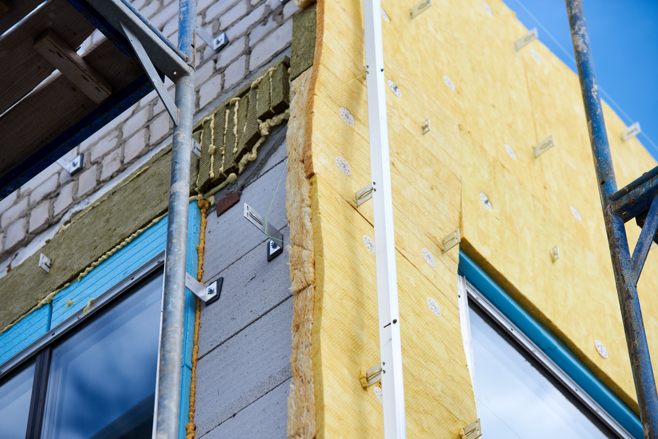
Fabric first is crucial when considering heat pumps
Notes:
One issue is that, to exaggerate the effectiveness of heat pumps, sensible measures can be excluded from the assessment ignoring Fabric First.

Slide 4
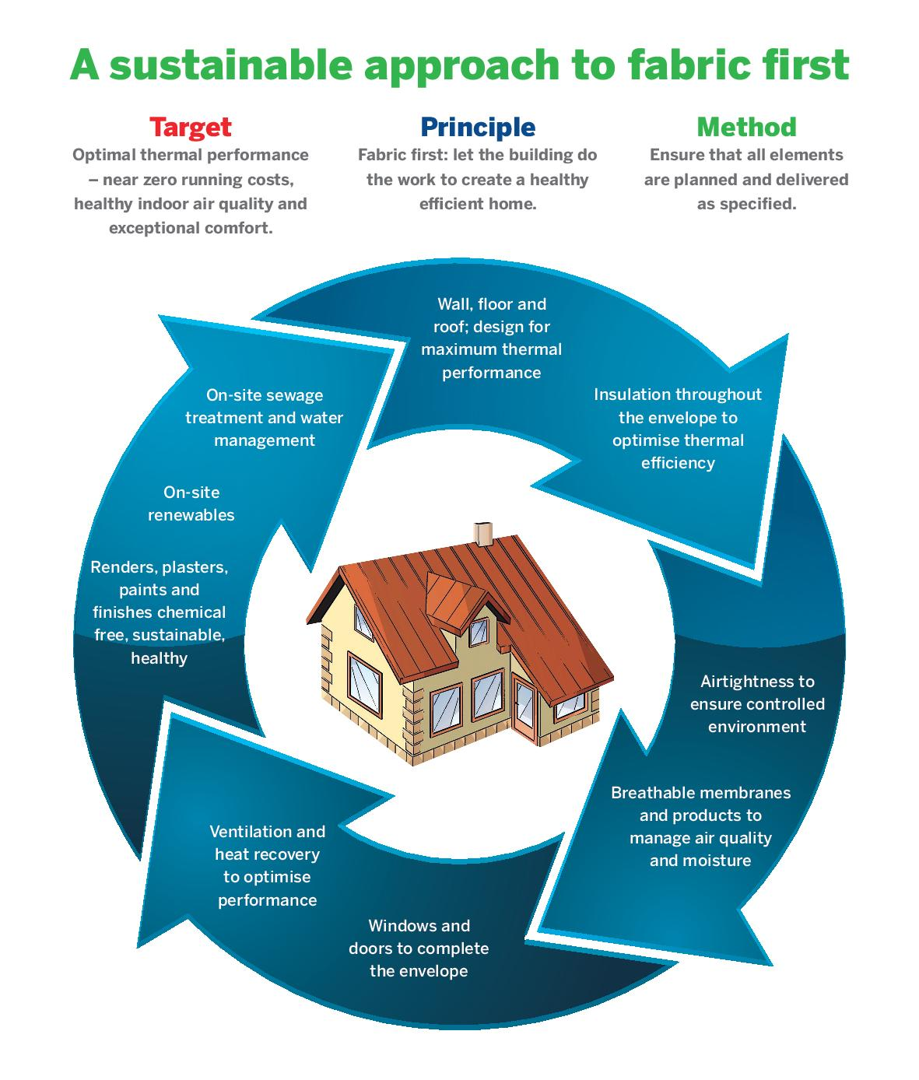
A fabric first approach prioritises upgrading a building's physical structure—insulation, airtightness, minimal thermal breaks and choice of windows to minimise heat loss before installing new heating technologies.
Notes:
This approach reduces energy demand, lowers bills, and improves comfort by fixing the envelope first.

Slide 5
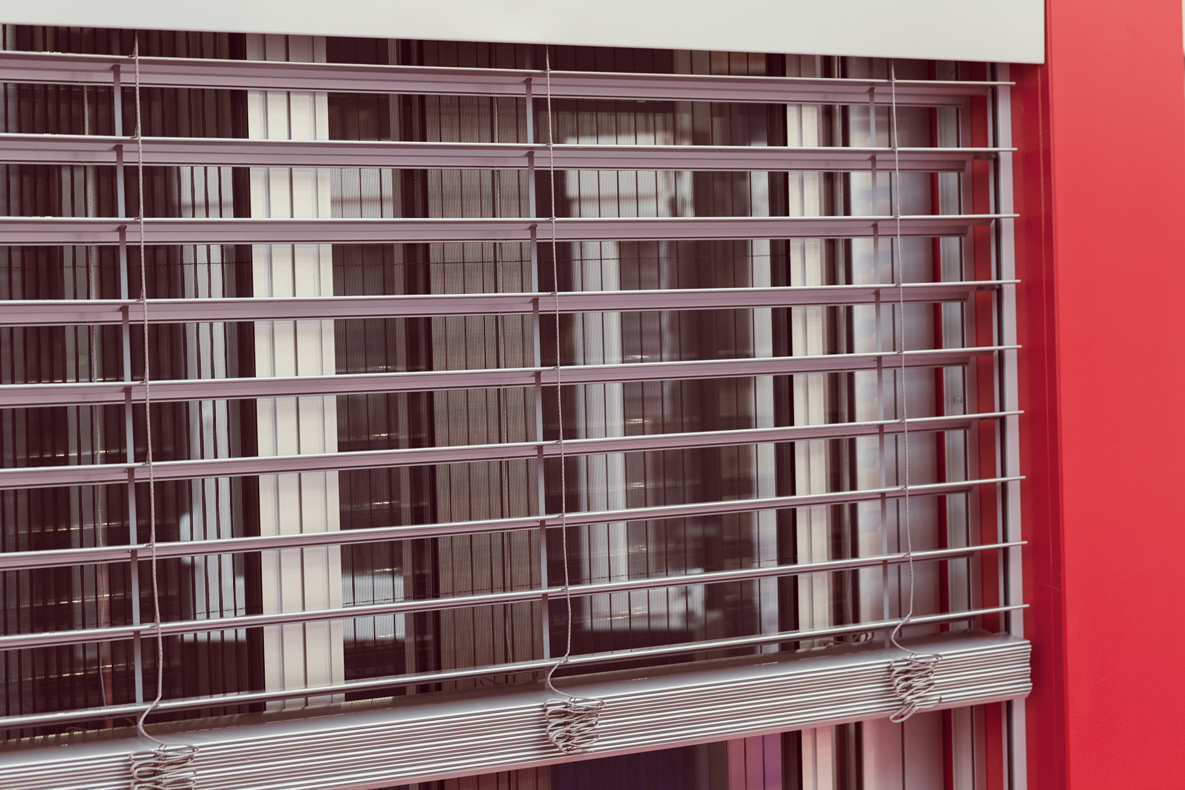
Whilst normally associated with summer cooling or the decoration at the window shading with dynamic blinds and shutters is the insulation of the glazing.
Notes:
The key weak spot for that are the windows and that is often the source of most of the lost heat.

Slide 6

Shading with external blinds and shutters that can adjust to the weather and external conditions can provide free heating energy on dull days and prevent heat gain on sunny days with minimal operating cost.
Notes:
Low-e triple is a costly solution that does not have the flexibility of dynamic shading. Beneficial solar gain in the heating season is blocked by the glazing whereas the shading can be raised to provide free heating solar energy. In the cooling season the glazing traps heat inside the room whereas the dynamic external shading intercepts most of it before it reaches the glass

Slide 7
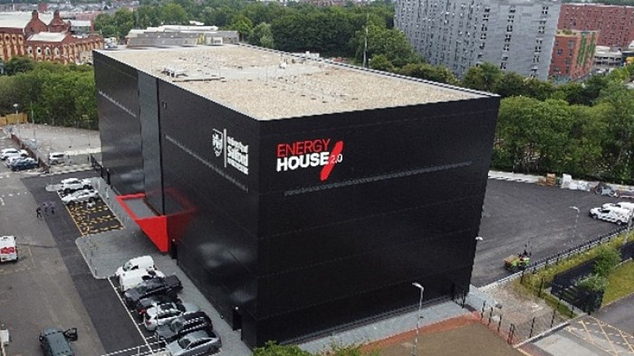
Energy House 2​
Do homes of the Future need shading?
BBSA research Project Salford University heat retention with shading
Notes:
Salford University Energy House has enabled their team to be able to maintain constant weather conditions to accurately assess heat loss performance. To assess the fabric first shading benefit the BBSA has utilised the facilities to test shading for winter heat retention

Slide 8
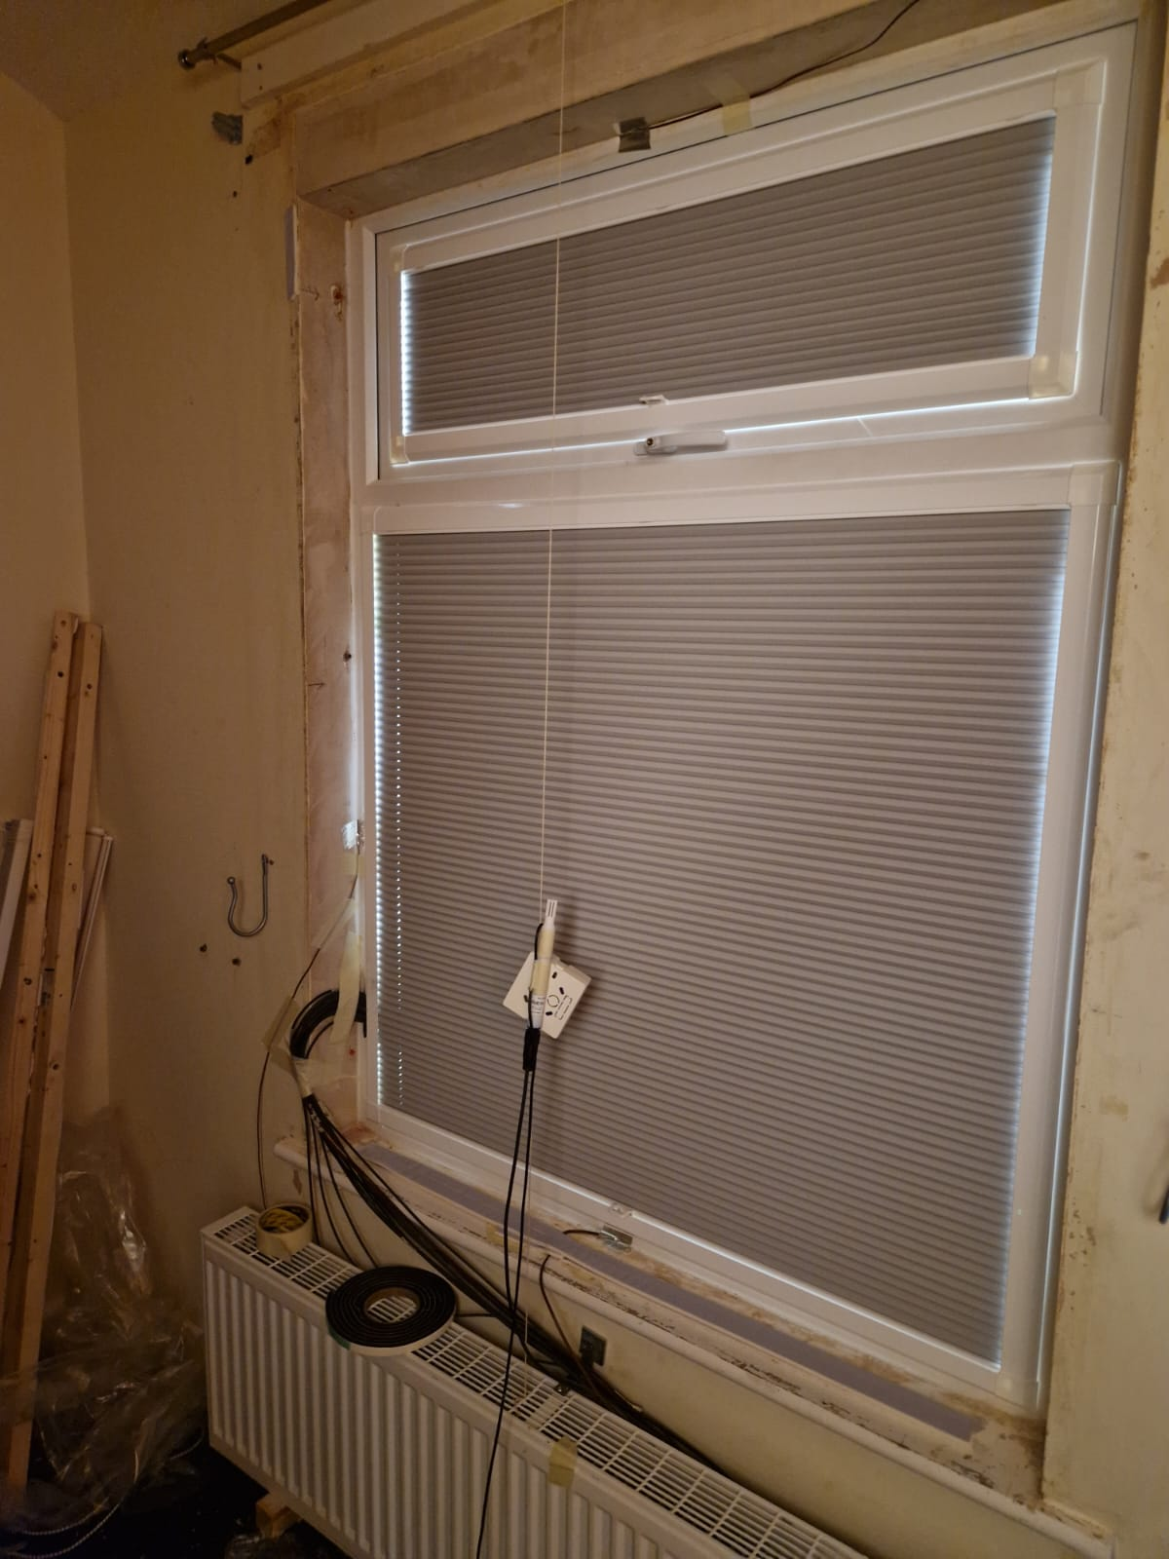
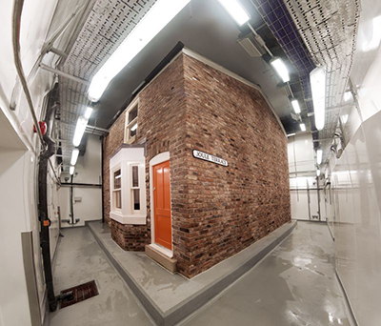
BBSA PROJECT
Salford Energy House 1
Thermal Heat Retention
Notes:
Heat loss in winter and the need to control the dynamic air-flow creating most of that loss can be controlled by shading reducing the cost of heat pump generated energy

Slide 9
The cheapest energy is the energy that you do not need to use shading can reduce heat loss by as much as 35% with no energy running cost
Notes:
It has been proven that appropriate shading with low-e double glazing can reduce heat loss by as much as 35% with no energy running cost, an investment that will be more quickly be recovered than the cost of the Heat Pump.

Slide 10
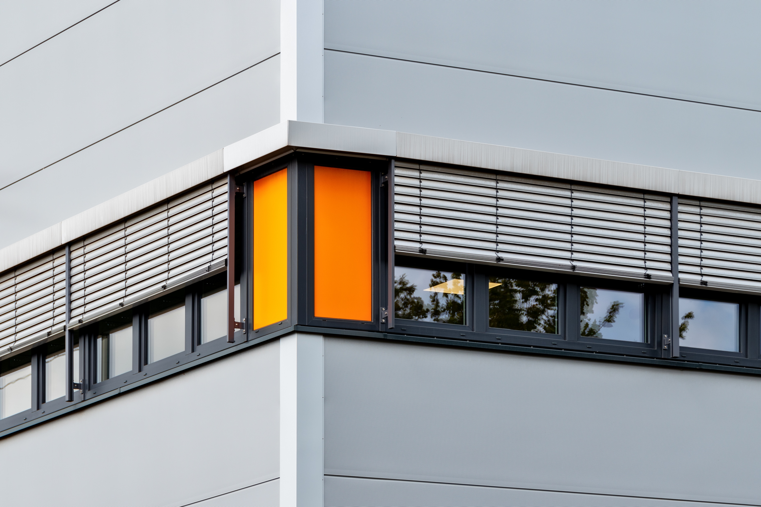
Shading is actually the insulation of the glazing
Notes:
Whilst internal blinds and shutters with frames to prevent loss at the edges are the usual option external shading such as shutters or zip screens will have a similar performance in creating a Fabric First barrier of air between the glass and blind reducing that loss.

Slide 11
Unlike heat pumps shading uses minimal energy
Notes:
Using energy consuming heat pumps, no matter how low the off peak tariff, is costing considerably more than closing the shading as that action does not use energy.

Slide 12
If your heat pump is underperforming it is a solution to consider.
If thinking of installing one consider the Fabric First principal of insulating the glazing with shading .
Notes:
If your heat pump is underperforming shading is a solution to consider. If thinking of installing one consider the Fabric First principal of insulating the glazing with shading .

Slide 13
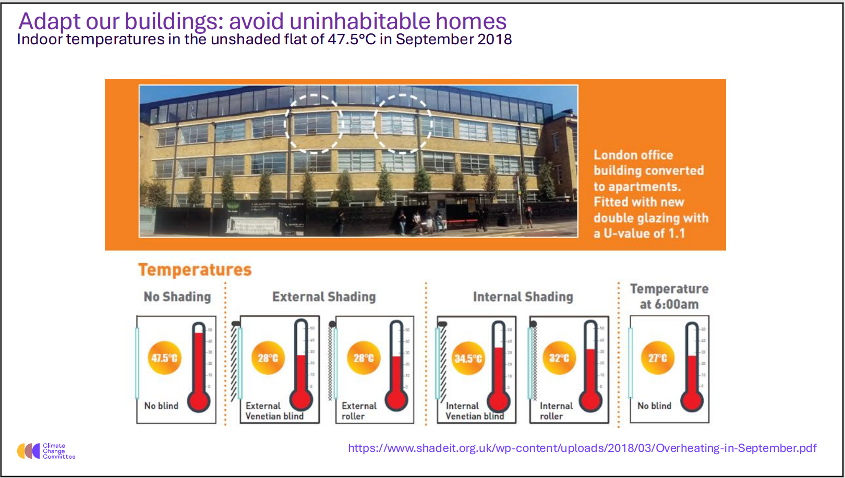
Recognition of the climate change committee
overheating has been identified by the Climate Change Committee as one of 8 crucial mitigation measures that are necessary to achieve their goals.
Significantly they identify that when shading measures are overlooked the cost of provision post contract can be as high as 3.5 times as much.
Notes:
Firstly overheating has been identified by the Climate Change Committee as one of 8 crucial mitigation measures that are necessary to achieve their goals. Significantly they identify that when shading measures are overlooked the cost of provision post contract can be as high as 3.5 times as much.

Slide 14
Part O Acceptable strategies for reducing overheating risk
Limiting solar gains
2.7 Solar gains in summer should be limited by any of the following means. a. Fixed shading devices, comprising any of the following.
Fixed relates to fixed to the building i. Shutters. ii. External blinds. iii. Overhangs. iv. Awnings.
Notes:
Part O of the Building regs. Defines that passive measures (dynamic blinds and shutters) must be considered before mechanical cooling.

